Slide 1

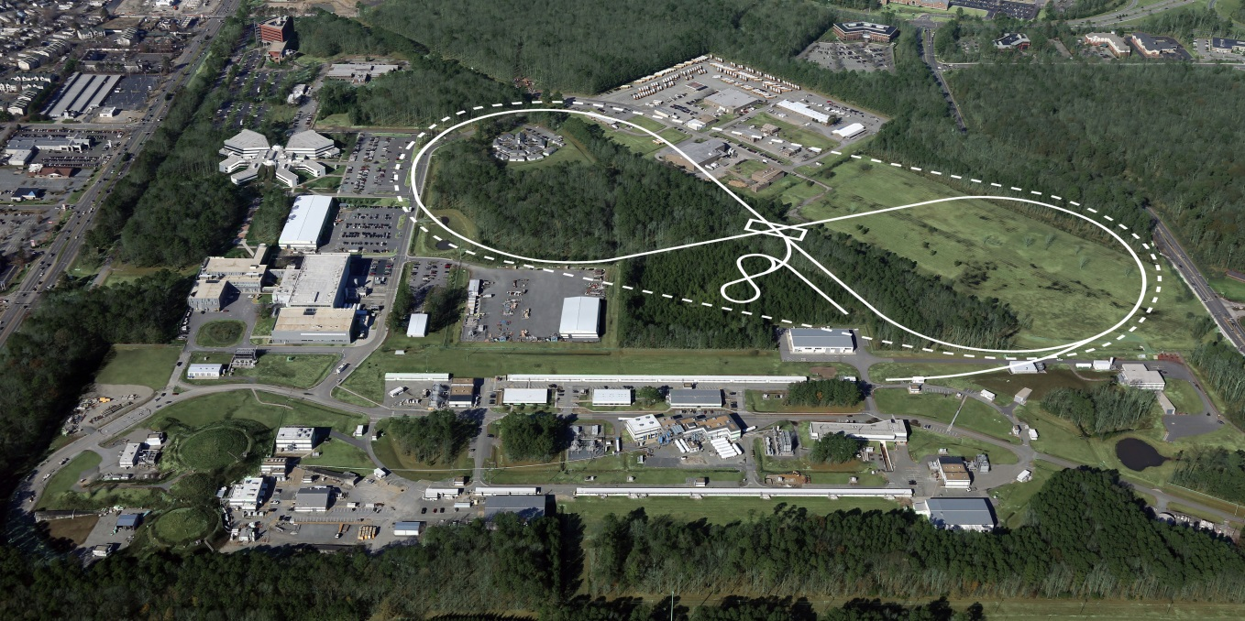
EIC: The Accelerator
Fulvia Pilat
HUGS Program
June 12, 2015

Slide 2
Outline
Accelerators “101”
http://www.aps.org/units/dpb/upload/accel_beams_2013.pdf
The EIC accelerator: intro
The EIC designs: MEIC and eRHIC
The MEIC baseline design
Towards the EIC realization
Conclusion

Slide 3
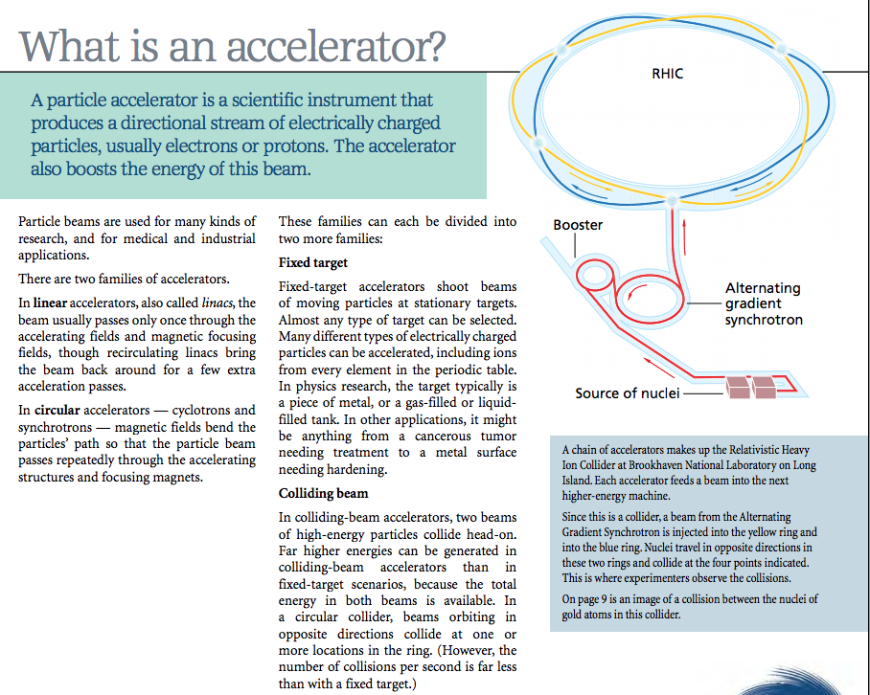
Accelerators “101”

Slide 4
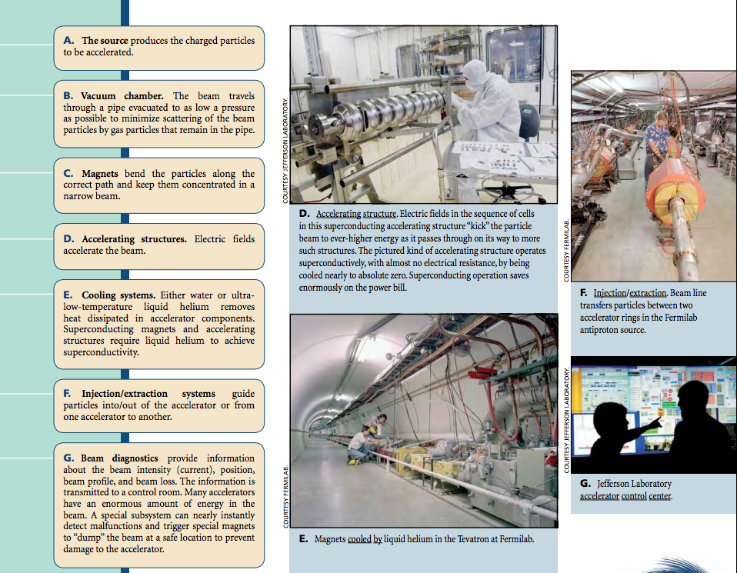
Accelerator “ingredients”

Slide 5
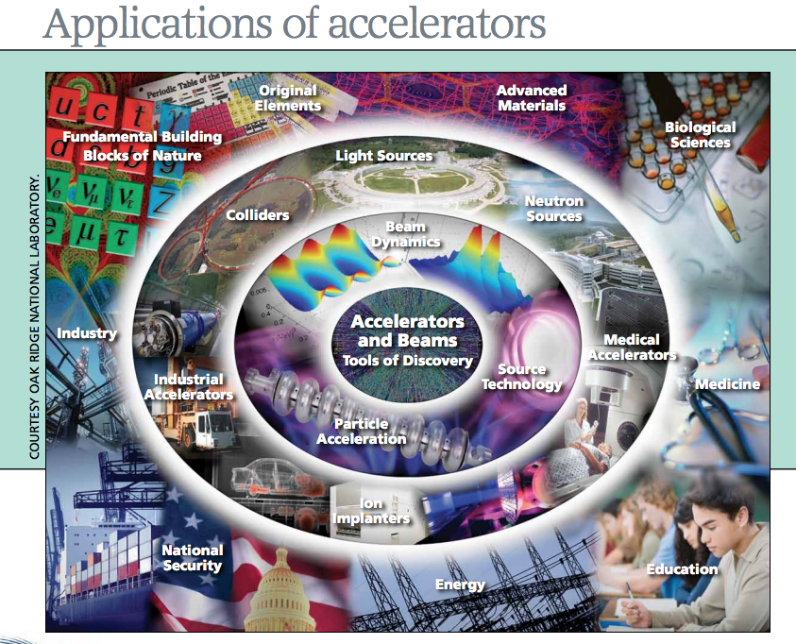
Accelerator types and applications

Slide 6
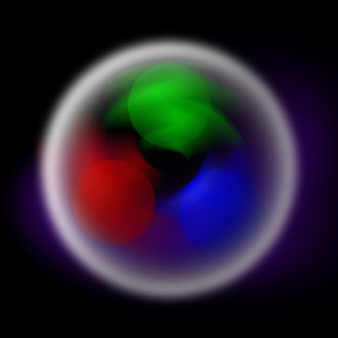
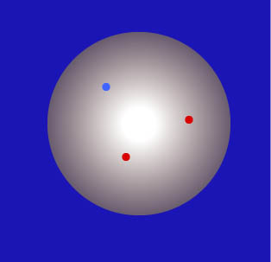
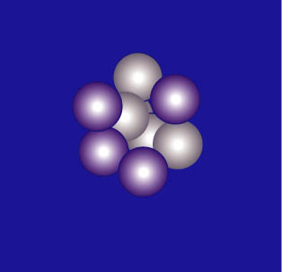
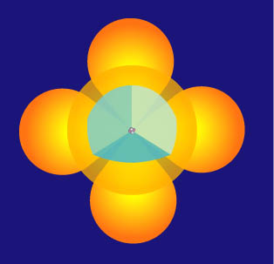
Particle Accelerators for fundamental research
Accelerators can be thought of as microscopes that probe the structure of atoms and fundamental particles.
10⁻¹⁵
Electrons (10⁻¹⁸ m )
Atom nucleus nucleon quark
10⁻¹⁰ m 10⁻¹⁴ m 10⁻¹⁵ m 10⁻¹⁸ m

Slide 7
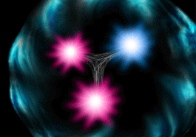
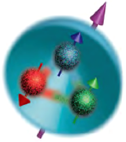

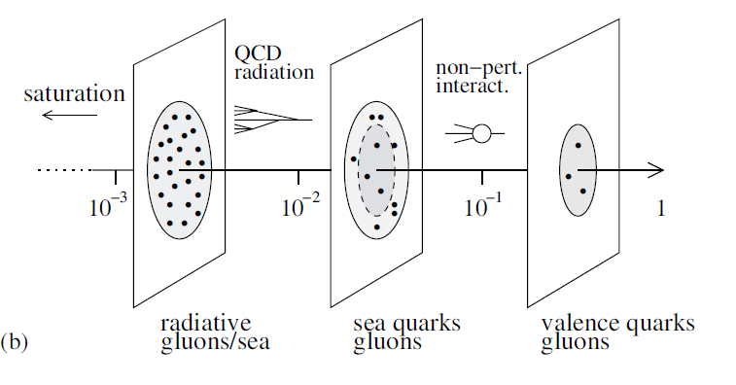
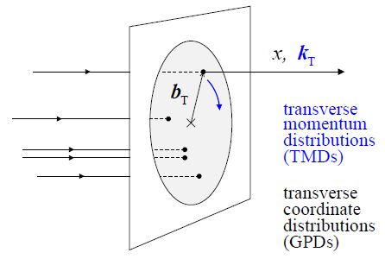
EIC Physics Highlights
An EIC will study the sea quark and gluon-dominated matter
  3D structure of nucleons and nuclei is not trivial
  Gluon dynamics plays a large role in proton spin
  Gluons in nuclei (splitting/recombining)
Need luminosity, polarization, large energy range and good acceptance to detect spectator & fragments
JLab
12 GeV
Stage I (MEIC)
Stage I+II (MEIC + EIC)

Slide 8

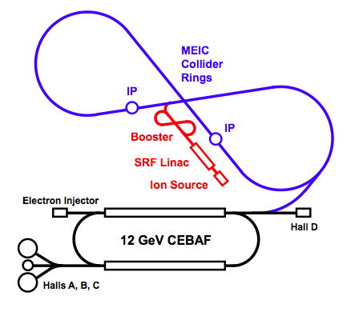
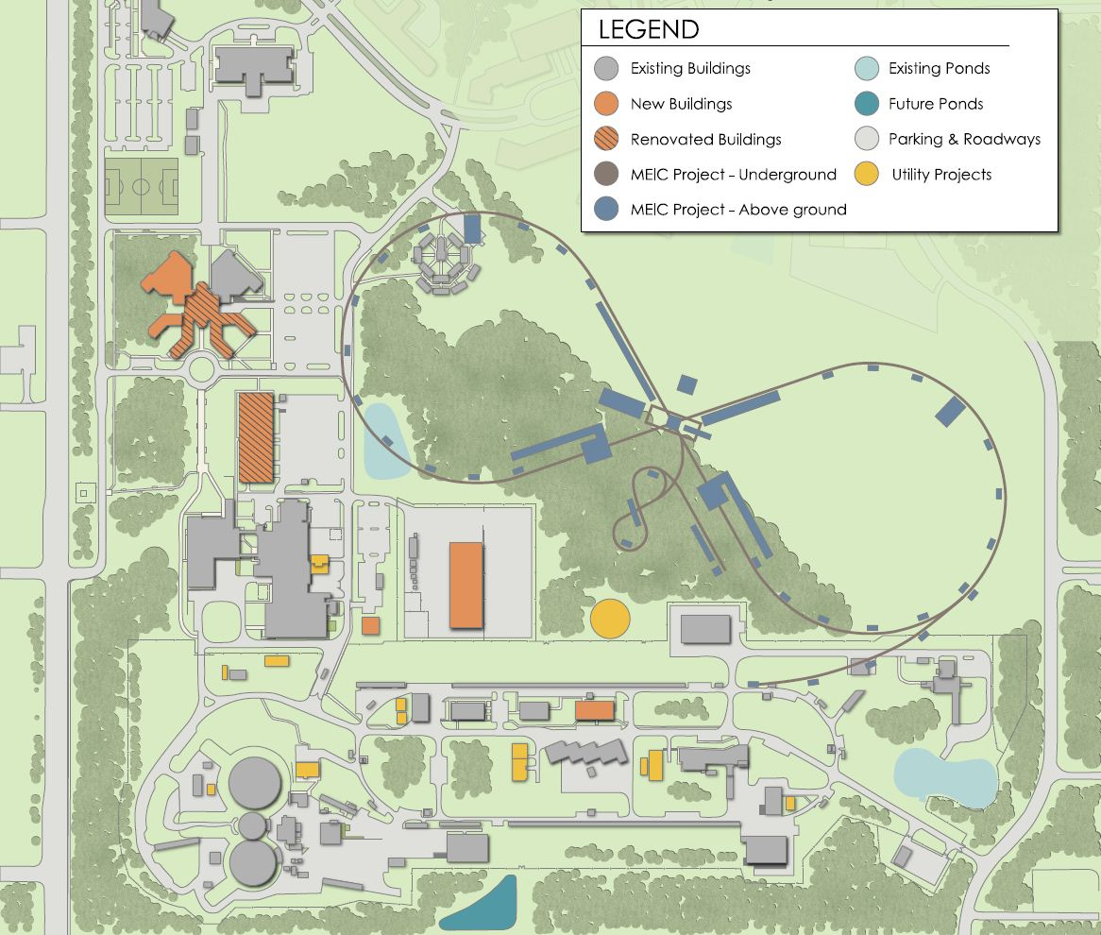
Medium Energy EIC@JLab
Booster
Linac
Ion Source
JLab Concept
Initial configuration (MEIC):
  3-10 GeV on 20-100 GeV ep/eA collider
  Fully-polarized, longitudinal and transverse
  Luminosity: >10³³ e-nucleons cm⁻² s⁻¹
  upgradeable to few x 10³⁴
    Upgradable to higher energies
    250 GeV protons + 20 GeV electrons

Slide 9
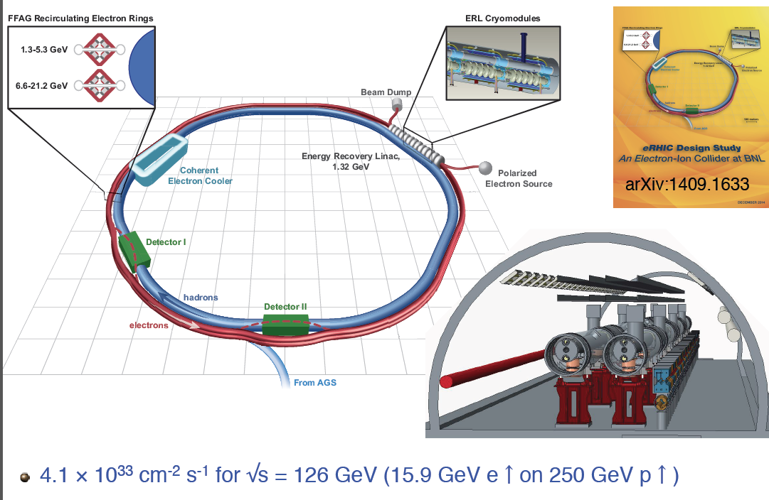
eRHIC@BNL

Slide 10
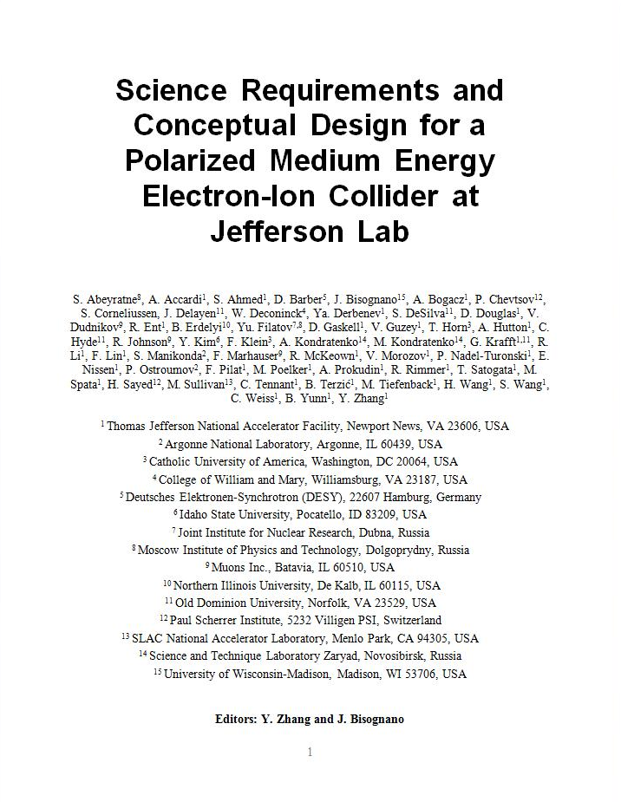
MEIC Design Goals
Energy
  Full coverage of √s from 15 to 65 GeV
  Electrons 3-10 GeV, protons 20-100 GeV, ions 12-40 GeV/u
Ion species
  Polarized light ions: p, d, ³He, and possibly Li
  Un-polarized light to heavy ions up to A above 200 (Au, Pb)
Space for at least 2 detectors
Full acceptance is critical for the primary detector
Luminosity
  10³³ to 10³⁴cm⁻²s⁻¹ per IP in a broad CM energy range
Polarization
  At IP: longitudinal for both beams, transverse for ions only
  All polarizations >70%
Upgrade to higher energies and luminosity possible
  20 GeV electron, 250 GeV proton, and 100 GeV/u ion
  Design goals consistent with the White Paper requirements

Slide 11
Design Strategy for High Luminosity
The MEIC design concept for high luminosity is based on high bunch repetition rate CW colliding beams
KEK-B already reached above 2x10³⁴ /cm²/s
Beam Design
High repetition rate
Low bunch charge
Short bunch length
Small emittance
“Traditional” hadrons colliders
Small number of bunches
Small collision frequency f
Large bunch charge n₁ and n₂
Long bunch length
Large beta-star
IR Design
Small β*
Crab crossing
Damping
Synchrotron radiation
Electron cooling

Slide 12
Design Strategy for High Polarization
Figure-8 shape has been chosen for all rings with the goal of achieving high ion and electron polarization
  Spin precession in one arc is exactly cancelled in the other
  Zero spin tune independent of energy
  Spin control and stabilization with small solenoids or other compact spin rotators
Advantage 1: Efficient preservation of ion polarization during acceleration
  Energy-independent spin tune
  High polarization of all light ions
Advantage 2: Ease of spin manipulation
  Any desired polarization orientation at the IP
  Spin flip
Advantage 3: A simple way to accommodate polarized deuterons
  Particles with small anomalous magnetic moment
Advantage 4: Strong reduction of electron depolarization thanks to the energy independent spin tune

Slide 13
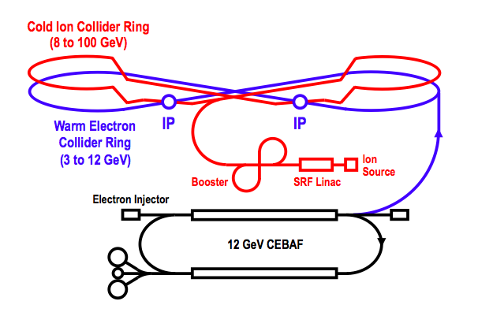
Baseline Layout
Booster
Warm Electron
Collider Ring
(3 to 10 GeV)
Linac
Ion Source
Booster
Linac
Ion Source
CEBAF is a full energy injector.
Only minor gun modification is needed
MEIC Cost Review December 18 2014

Slide 14
JLAB Campus Layout
~2.2 km circumference
Tunnel consistent
with a 250+ GeV upgrade
IP
MEIC
IP
CEBAF

Slide 15
MEIC Baseline
Baseline for the cost estimate
Collider ring circumference: ~2100 m
Electron collider ring and transfer lines : PEP-II magnets, RF (476 MHz) and vacuum chambers
Ion collider ring: super-ferric magnets
Booster ring: super-ferric magnets
SRF ion linac
Energy range
Electron: 3 to 10 GeV
Proton: 20 to 100 GeV
Lead ions: up to 40 GeV
Design point | p energy (GeV) | e- energy (GeV) | Main luminosity limitation
low | 30 | 4 | space charge
medium | 100 | 5 | beam beam
high | 100 | 10 | synchrotron radiation

Slide 16
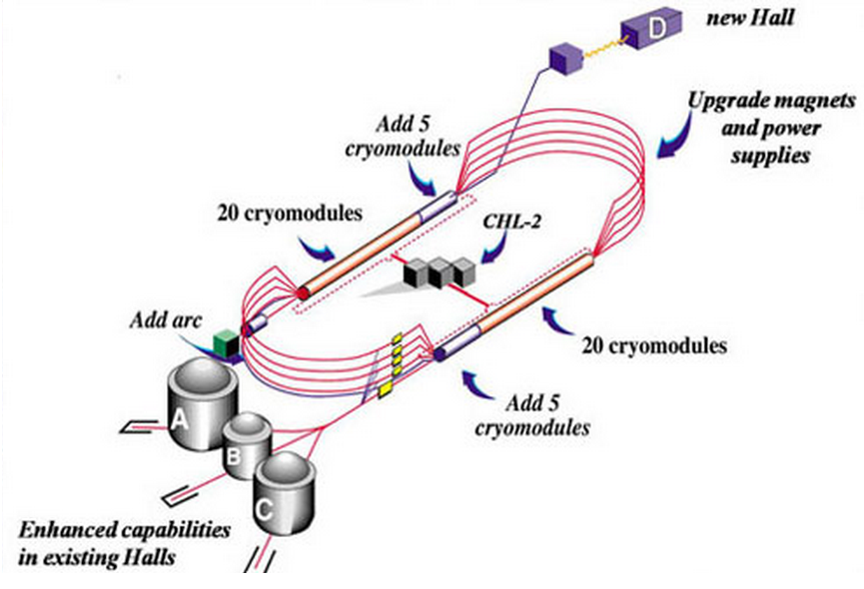
CEBAF - Full Energy Injector
CEBAF fixed target program
  5-pass recirculating SRF linac
  Exciting science program beyond 2025
  Can be operated concurrently with the MEIC
e⁻ collider ring
CEBAF will provide for MEIC
  Up to 12 GeV electron beam
  High repetition rate (up to 1497 MHz)
  High polarization (>85%)
  Good beam quality up to the mA level

Slide 17
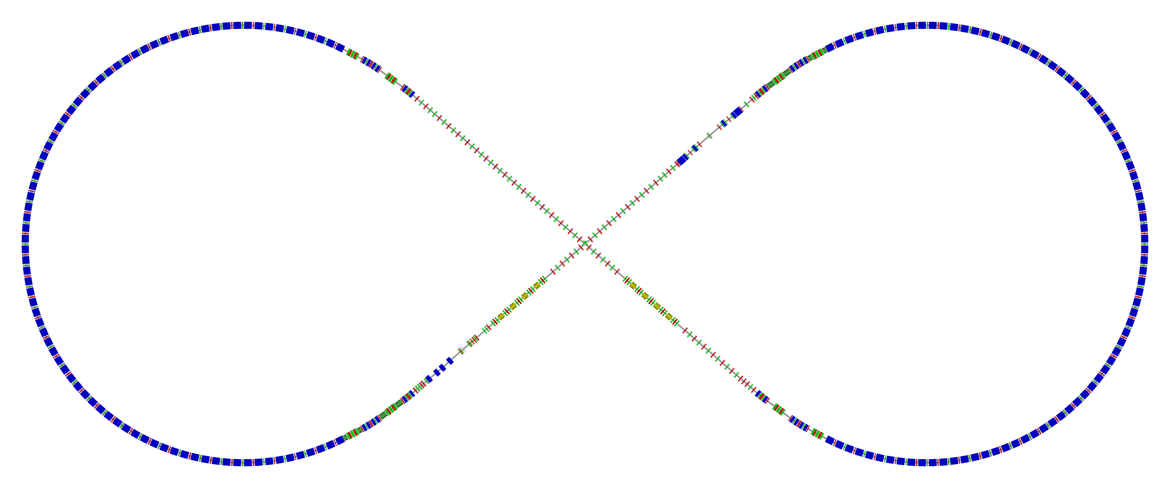
Electron Collider Ring
Electron collider ring design
  Circumference of 2154.28 m = 2 x 754.84 m arcs + 2 x 322.3 m straights
  Reuses PEP-II magnets, vacuum chambers and RF
Beam characteristics
  3A beam current up to 6.95 GeV
  Synchrotron radiation power density 10kW/m
  Total power 10 MW
Spin rotator
Spin rotator
CCB
Tune trombone & Straight FODOs
R=155m
81.7°
e⁻
Arc, 261.7°
Future 2nd IP
RF
RF
Spin rotator
IP: β_{x,y}*=(10,2)cm
Spin rotator
Forward e⁻ detection

Slide 18
Ion Sources and Linac
RFQ
QWR
QWR
HWR
Ion Sources
IH
4 cryostats
2
10 cryostats
4 cryos
2 cryos
10 cryos
MEBT
Optimum lead stripping energy: 13 MeV/u
  ABPIS for polarized or un-polarized light ions, EBIS and/or ECR for un-polarized heavy ions
Linac design based on the ANL linac design. Pulsed linac capably of accelerating multiple charge ion species (H⁻ to Pb⁶⁷+)
  Warm Linac sections (115 MHz)
    RFQ (3 m)
    MEBT (3 m)
    IH structure (9 m)
  Cold Linac sections
    QWR + QWR (24 + 12 m) 115 MHz
    Stripper, chicane (10 m) 115 MHz
    HWR section (60 m) 230 MHz
Ion species: p to Pb
Ion species for the reference design | ²⁰⁸Pb
Kinetic energy (p, Pb) | 285 MeV 100 MeV/u
Maximum pulse current: Light ions (A/Q<3) Heavy ions (A/Q>3) | 2 mA 0.5 mA
Pulse repetition rate | up to 10 Hz
Pulse length: Light ions (A/Q<3) Heavy ions (A/Q>3) | 0.50 ms 0.25 ms
Maximum beam pulsed power | 680 kW
Fundamental frequency | 115 MHz
Total length | 121 m

Slide 19
Booster
Purpose of Booster
  Accumulation of ions injected from Linac
  Acceleration of ions
  Extraction and transfer of ions to the collider ring
8 GeV Booster design
  Based on super-ferric magnet technology
  Circumference of 273 m
  Achromatic arcs’ design with partly negative horizontal dispersion to minimize momentum compaction to avoid transition crossing
  Figure-8 shape for preserving ion polarization
E_{kin} = 285 MeV – 8 GeV
Crossing angle:
75 deg.
RF cavity
extraction
injection
70
7
BETA_X&Y[m]
DISP_X&Y[m]
0
0
BETA_X
BETA_Y
DISP_X
DISP_Y
272.306
-7
Inj. Arc (255⁰)
Straight
Arc (255⁰)
Straight (RF + extraction)

Slide 20
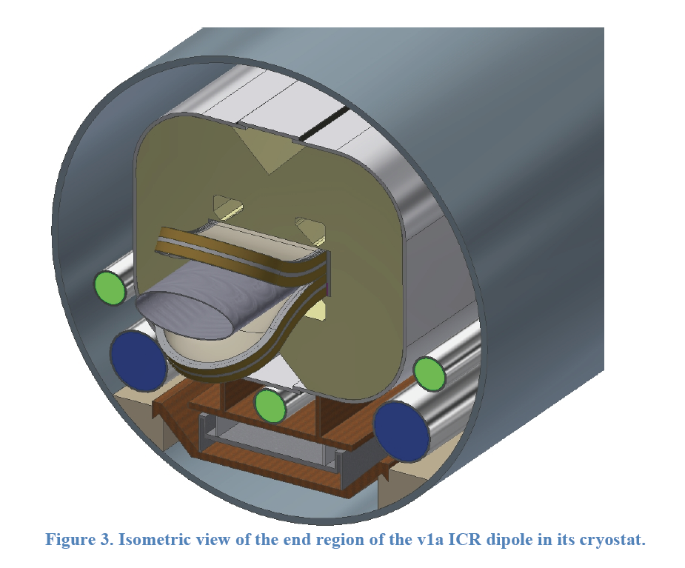
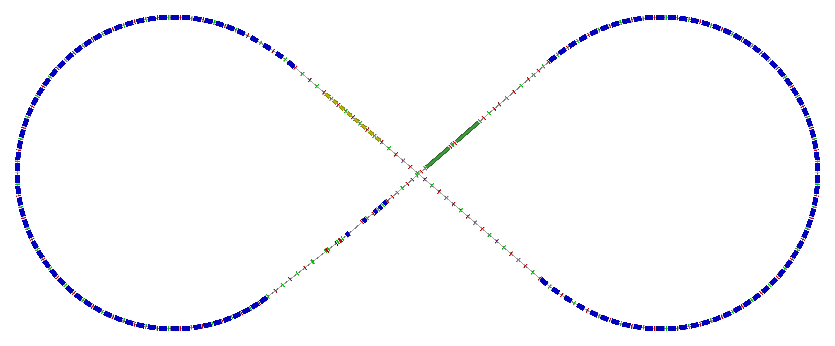
Ion Collider Ring Layout
Ion collider ring design
  match the geometry of PEP-II-component-based electron ring
  Use Super-ferric magnets
    ~3 T maximum field for maximum proton momentum of 100 GeV/c, 4.5 k operating temperature
    Cost effective construction and operation (factor of ~2 cheaper to operate, GSI
norm.+
SRF
Arc, 261.7°
elec. cool.
tune
tromb.+
match
81.7°
R = 155.5 m
future 2nd IP
det. elem.
ions
IP: β_{x,y}*=(10,2)cm
disp. supp./
geom. match
disp. supp. / geom. match

Slide 21
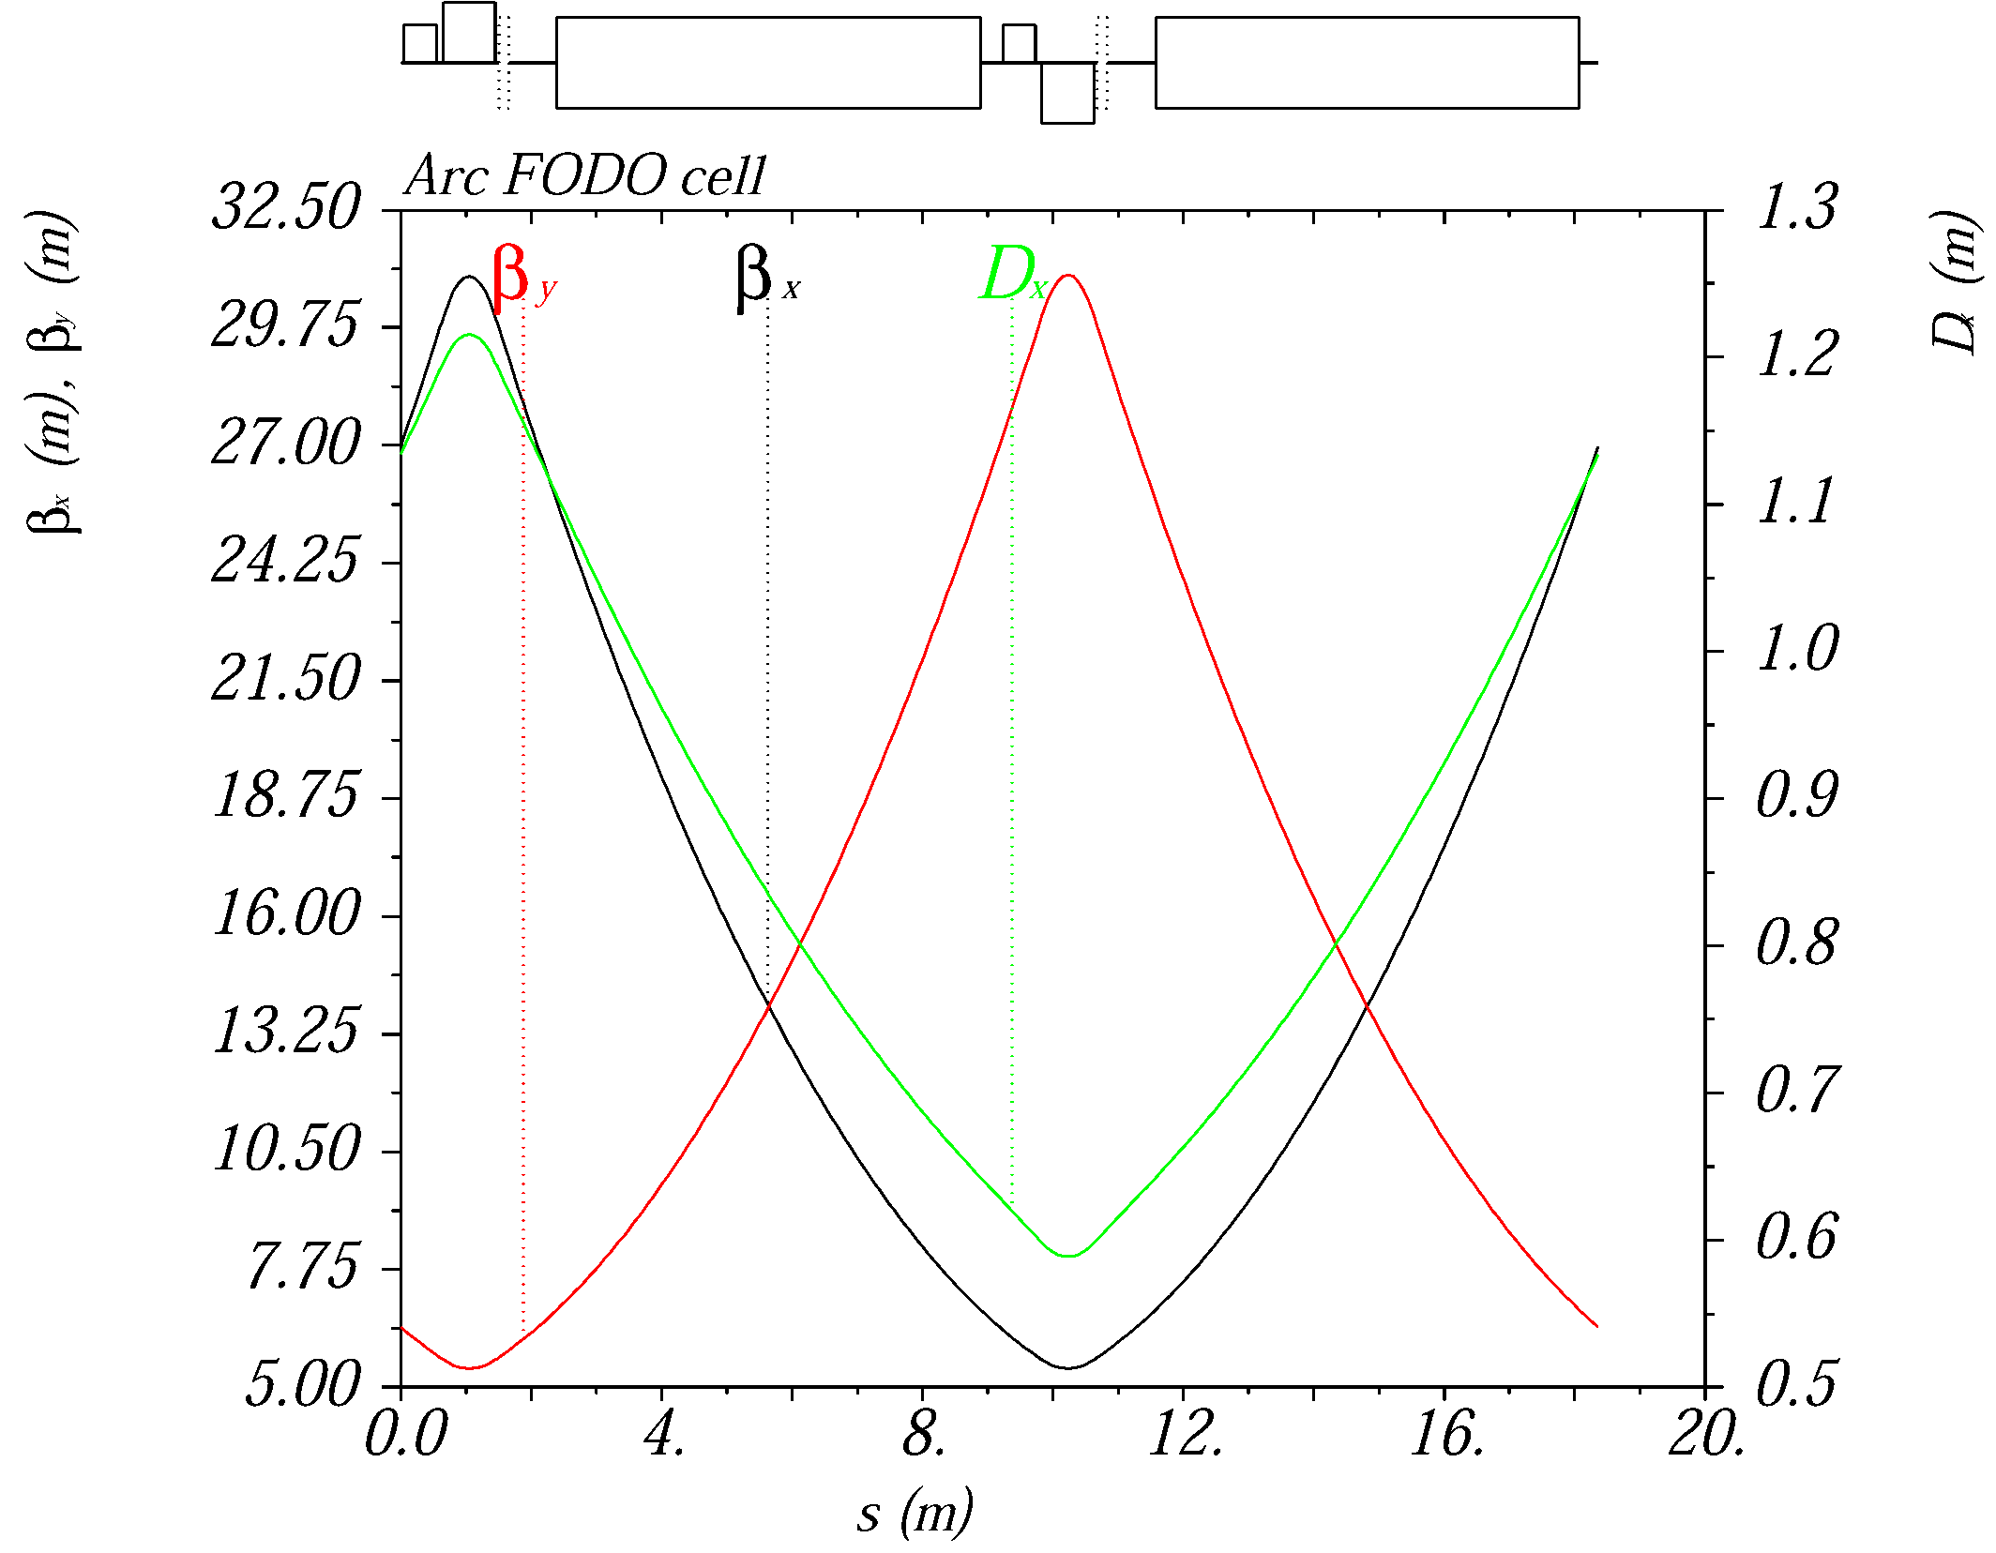
Ion Collider Ring with Super-Ferric Magnets
~2.2 km circumference to match PEP-II-magnet-based electron ring
Super-ferric magnets for the ion collider ring
  ~3 T maximum field, 4.5 K operating temperature
  Cost effective, construction and operation ( factor of ~2 cheaper to operate, GSI)
Maximum proton momentum of 100 GeV/c
The lattice is based on a FODO cell
length of 22.8 (1.5x PEP-II FODO cell)
optimized for an 8m long SF dipole
magnet
The lattice is fully matched

Slide 22
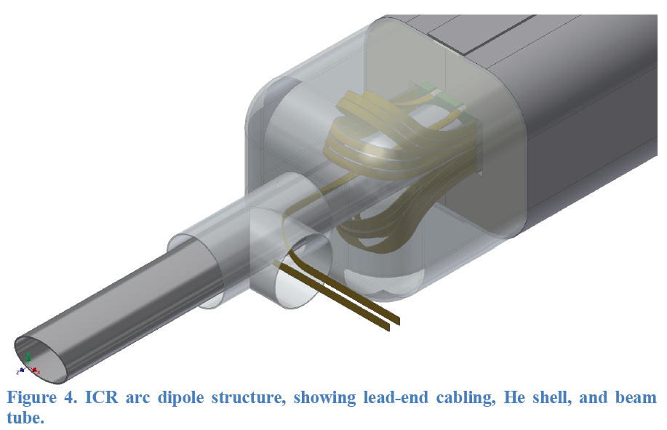
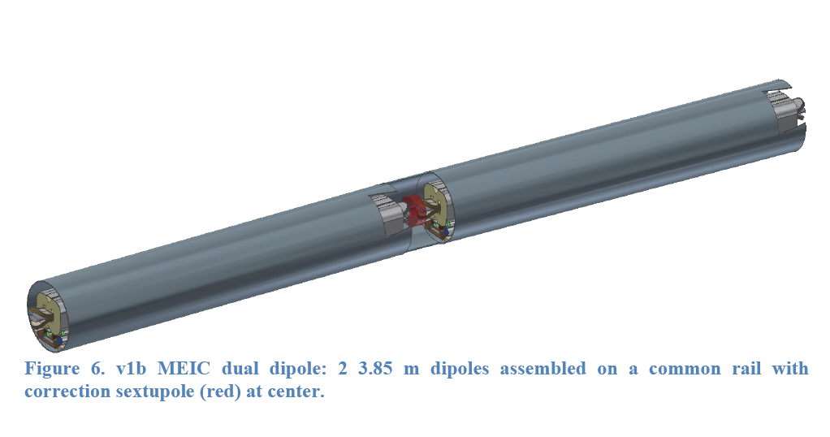
MEIC super-ferric dipole
2 X 4m long dipole
NbTi cable
3 T
Correction sextupole
Common cryostat

Slide 23
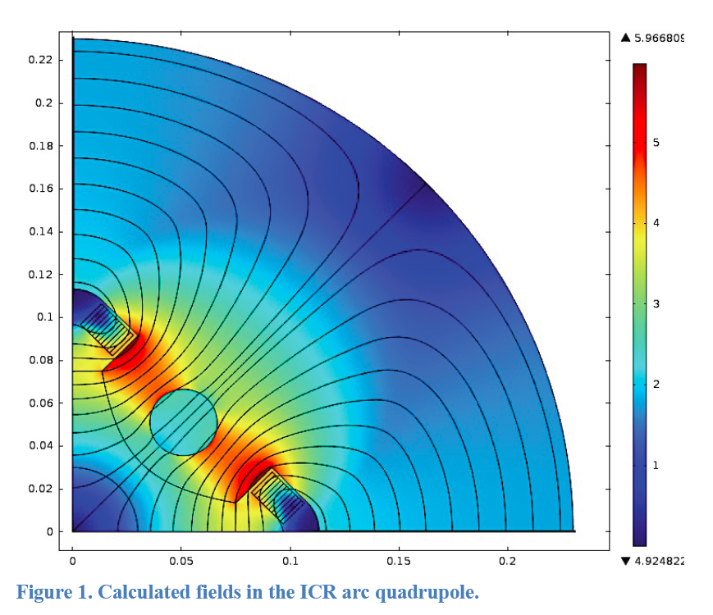
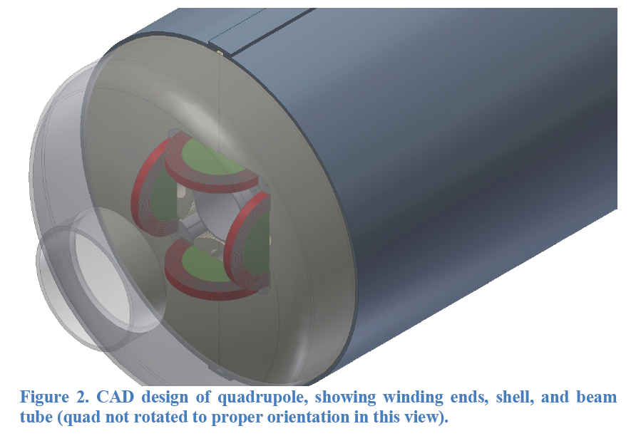
MEIC super-ferric Quadrupole
Arc quads ~50 T/m SF
Matching quads ~80 T/m SF
FF triplets cos-θ

Slide 24
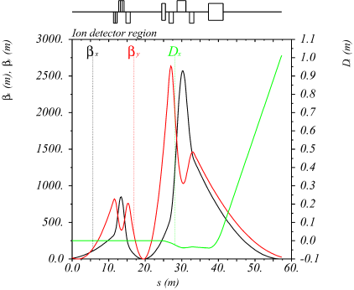
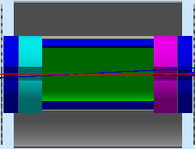
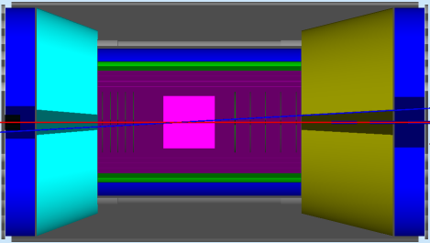
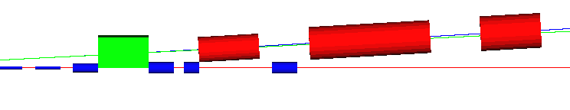
Full-Acceptance Detector
50 mrad crossing angle
  No parasitic collision, fast beam separation, improved detection
Forward hadron detection in three stages
  Endcap
  Small dipole covering angles up to a few degrees
  Far forward, up to one degree, for particles passing through accelerator quads
Low-Q² tagger
  Small-angle electron detection
IP
FP
central detector
with endcaps
small angle
hadron detection
far forward
hadron detection
low-Q²
electron detection
n, γ
large-aperture
electron quads
ion quads
~60 mrad bend
p
small-diameter
electron quads
e
p
Thin exit windows
Fixed trackers
50 mrad beam
(crab) crossing angle
Roman pots
(from GEANT4)
dual-solenoid in common cryostat
4 m coil
RICH
+
TORCH?
Endcap
1 m
1 m
Ion quadrupoles
barrel DIRC + TOF
2 Tm dipole
e/π threshold
Cherenkov
Electron quadrupoles
EM calorimeter
Tracking
EM calorimeter
Trackers and “donut” calorimeter
EM calorimeter

Slide 25
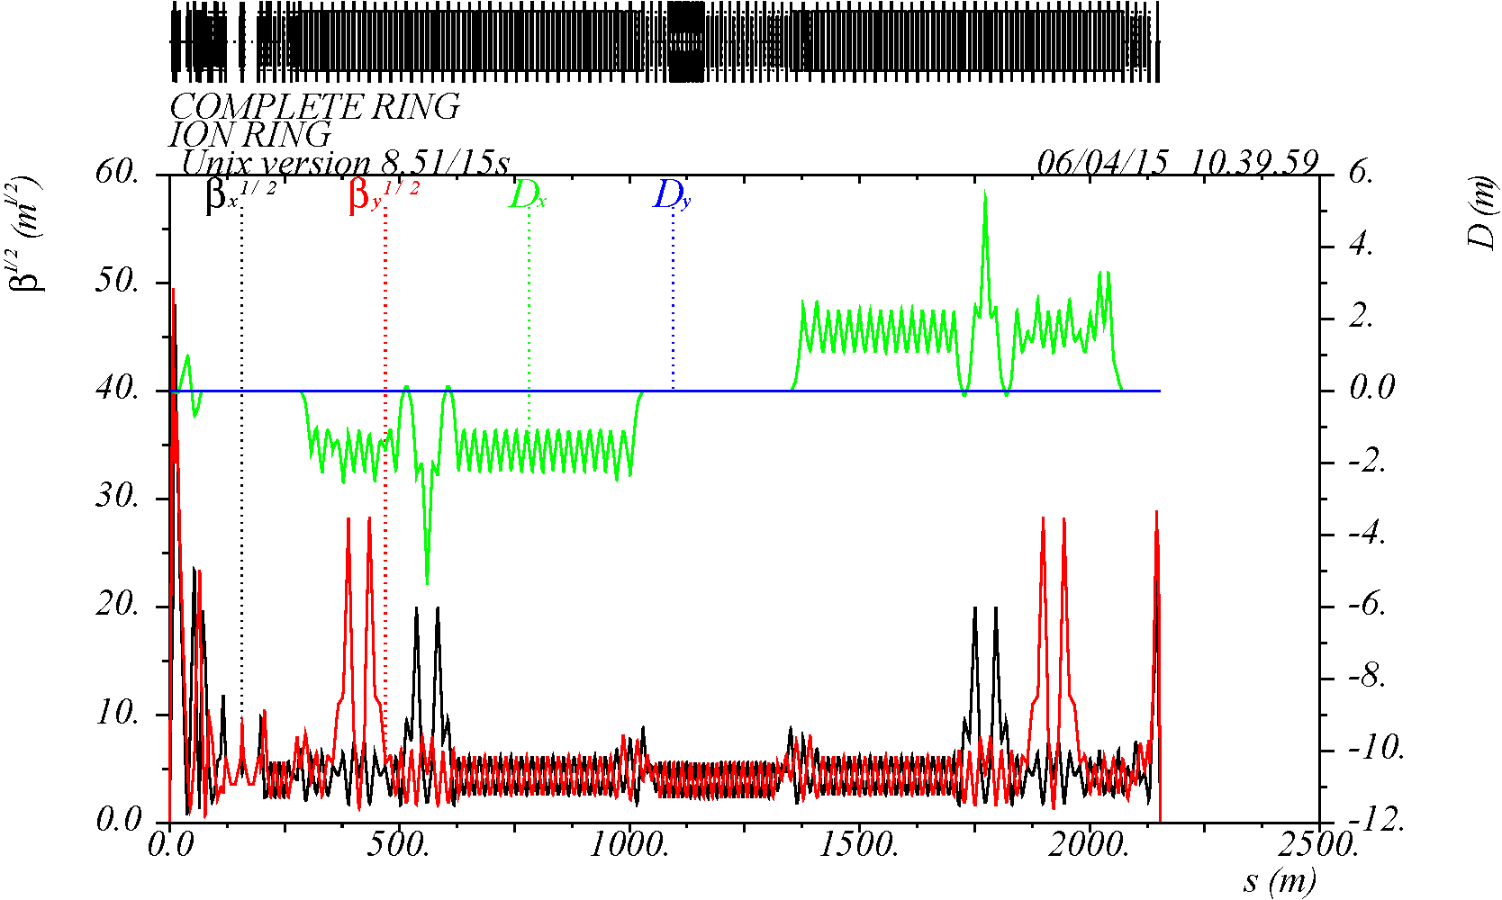
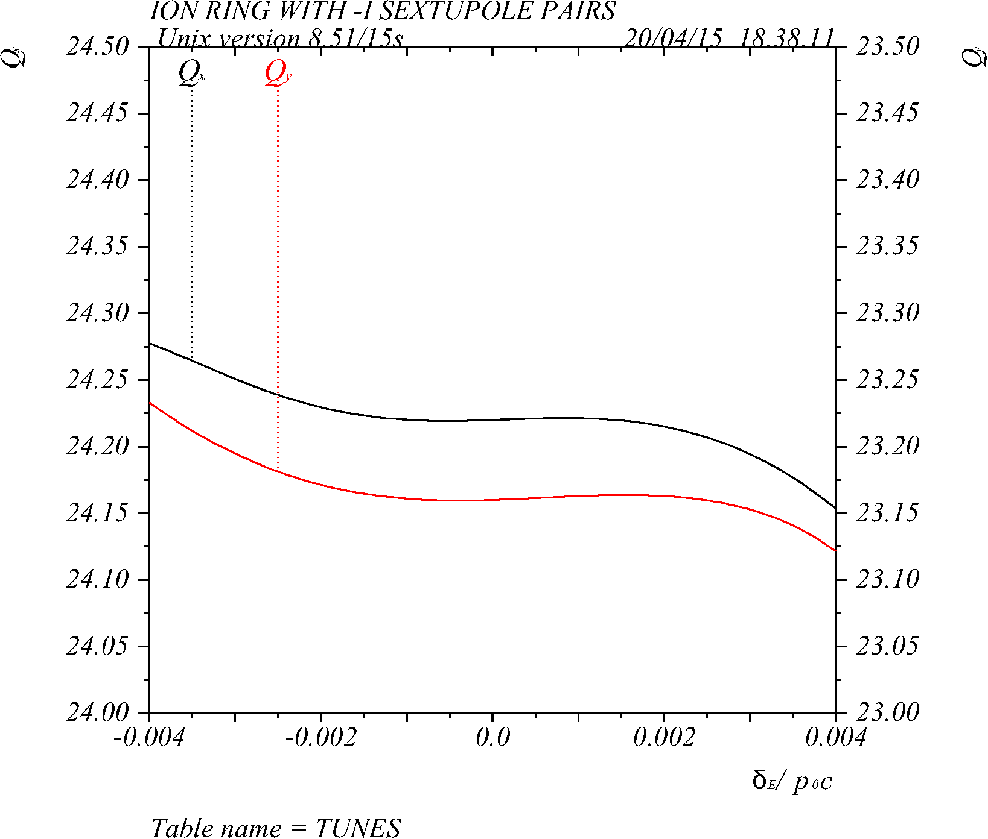
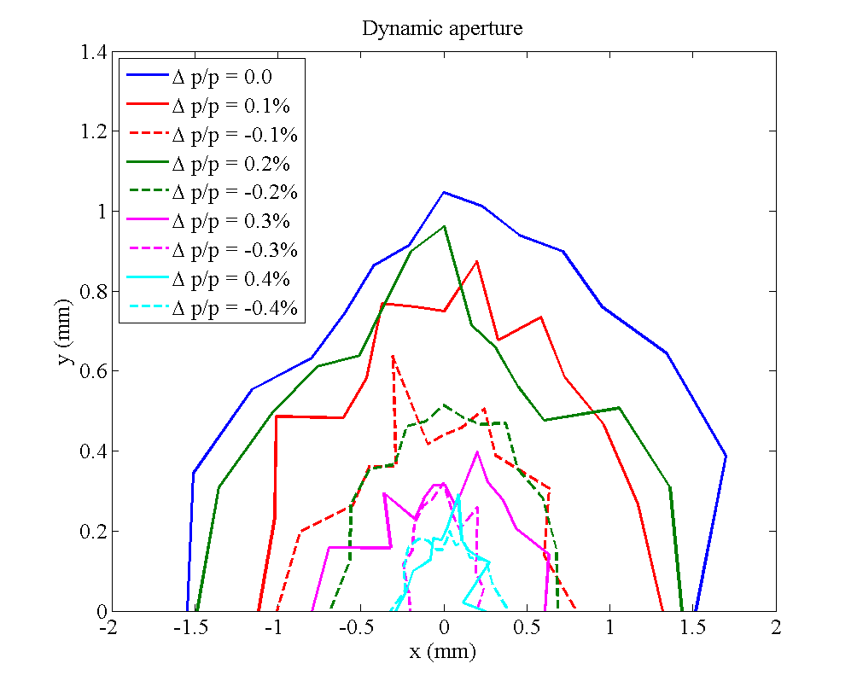
Chromaticity Compensation
Distributed sextupole compensation strategy
  “-I” approach with two sextupole families to build up chromatic β wave in the arcs to cancel FFB’s chromatic kick
  Another two sextupole families with π/2 phase advance to compensate the residual linear chromaticities
  Control of chromatic driving terms and cancellation of geometric resonance driving terms to first order in sextupole strength
ion ring optics
IP
Dynamic Aperture (DA)
Momentum Acceptance
At Δp/p = 0.3%
(- 20σ_{x} , + 20σ_{x})
(- 40σ_{y} , + 40σ_{y})
(- 12σ_{Δp/p} , + 12σ_{Δp/p})

Slide 26
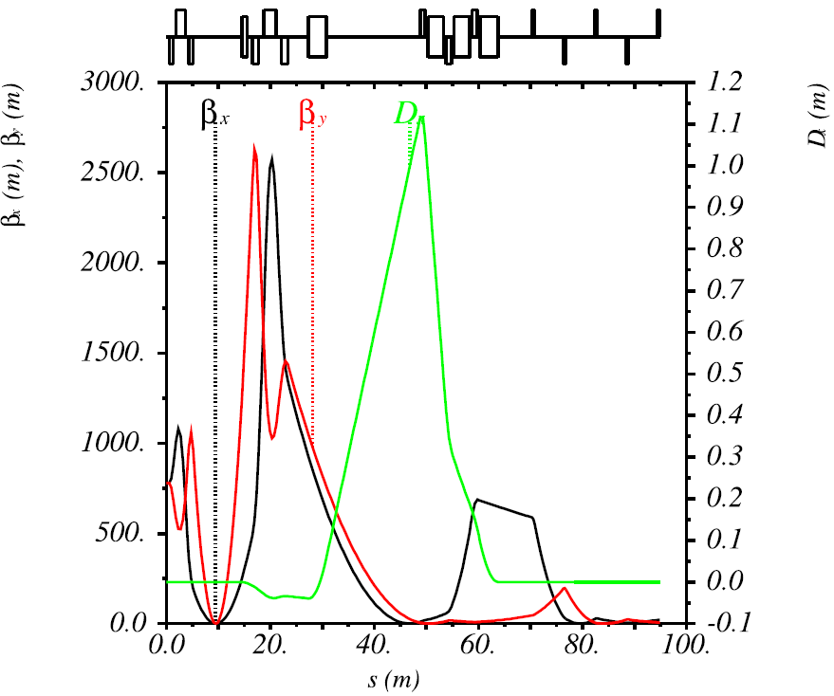
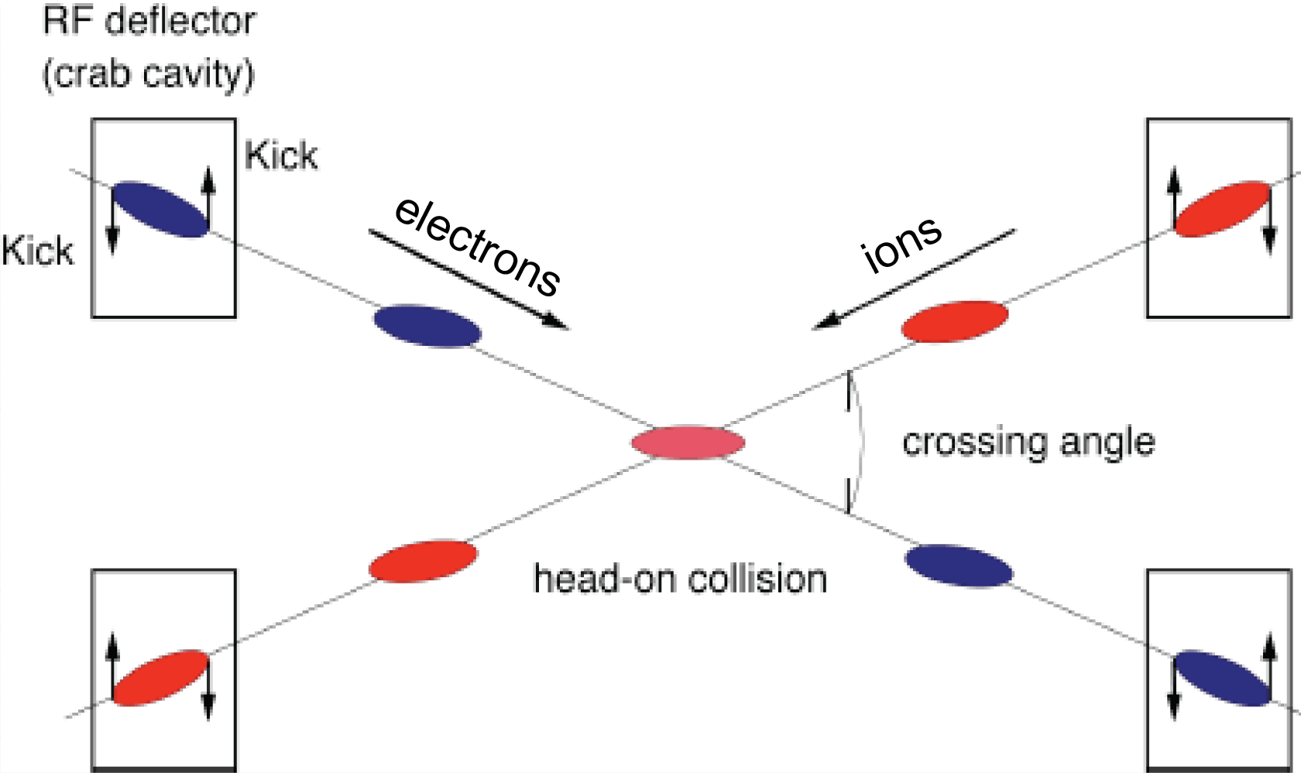
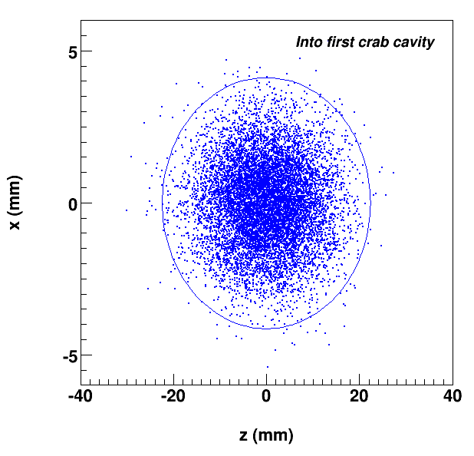
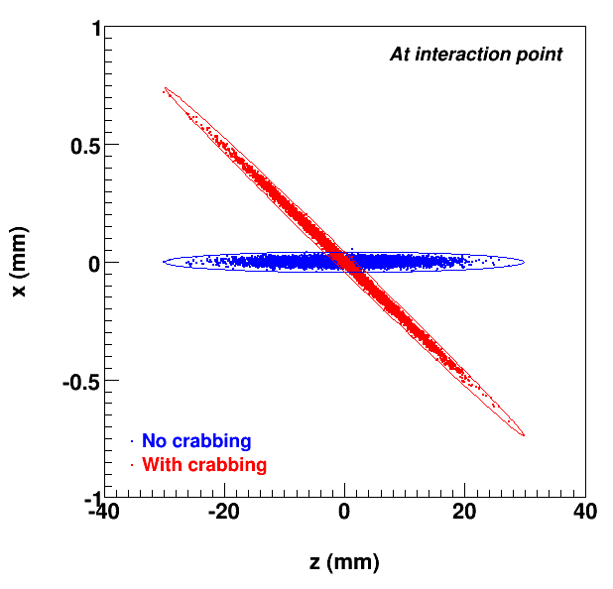
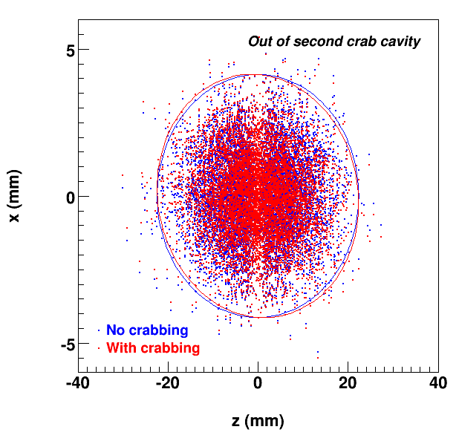
Crab Crossing
Effective head-on bunch collisions restored with 50 mrad crossing angle
Local crab scheme
Cavities are placed at (n+1)π/2 phase advance relative to IP
Large β_{x} at location of crab cavities for minimizing the required kicking voltage
Deflective crabbing using transverse
electric field of SRF cavities
  design and analysis completed
  Prototype fabricated and characterized
  Final testing with promising results
Location of crab cavities
π/2
3π/2
Incoming
At IP
Outgoing

Slide 27
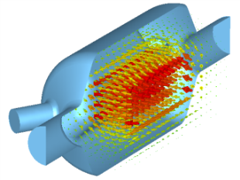
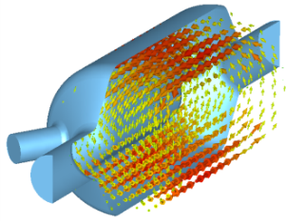
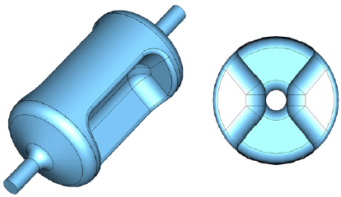
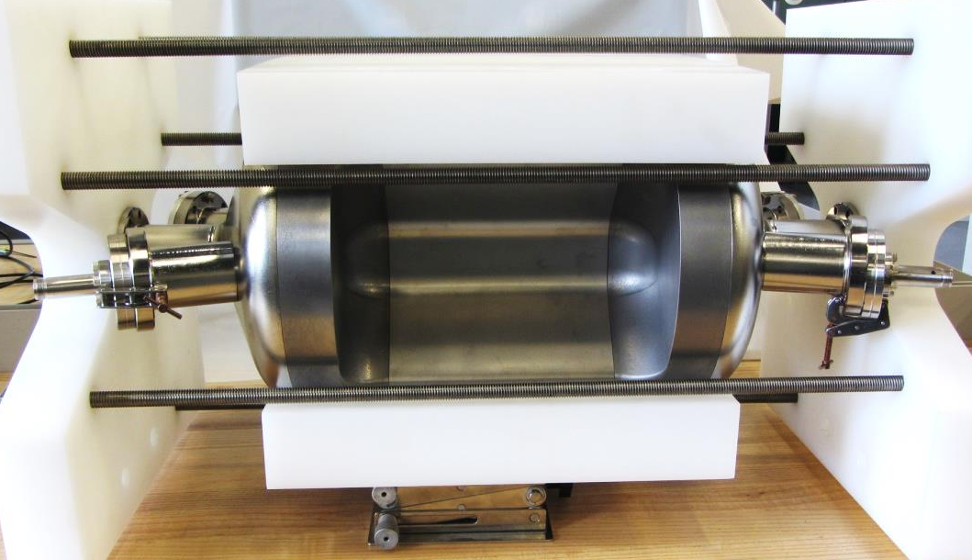
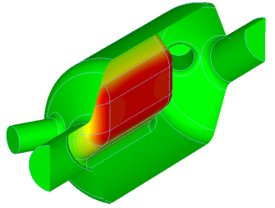
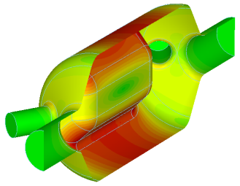
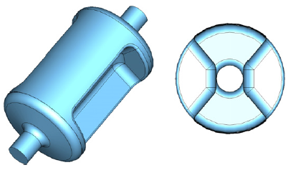
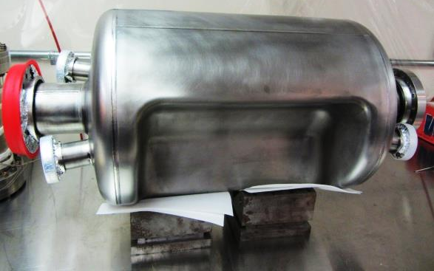
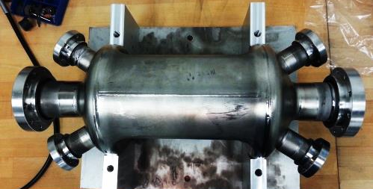
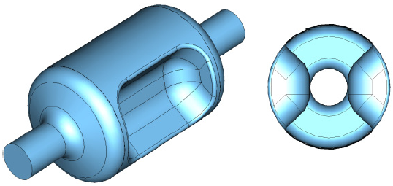
Deflective Crab Cavity
499 MHz Deflecting Cavity for Jefferson Lab 12 GeV Upgrade
44 cm
24 cm
400 MHz Crabbing Cavity for LHC HiLumi Upgrade
53 cm
SRFD test results
34 cm
750 MHz Crabbing Cavity
35 cm
S. De Silva ICFA Workshop in HOMs for SRF 2014
19 cm

Slide 28
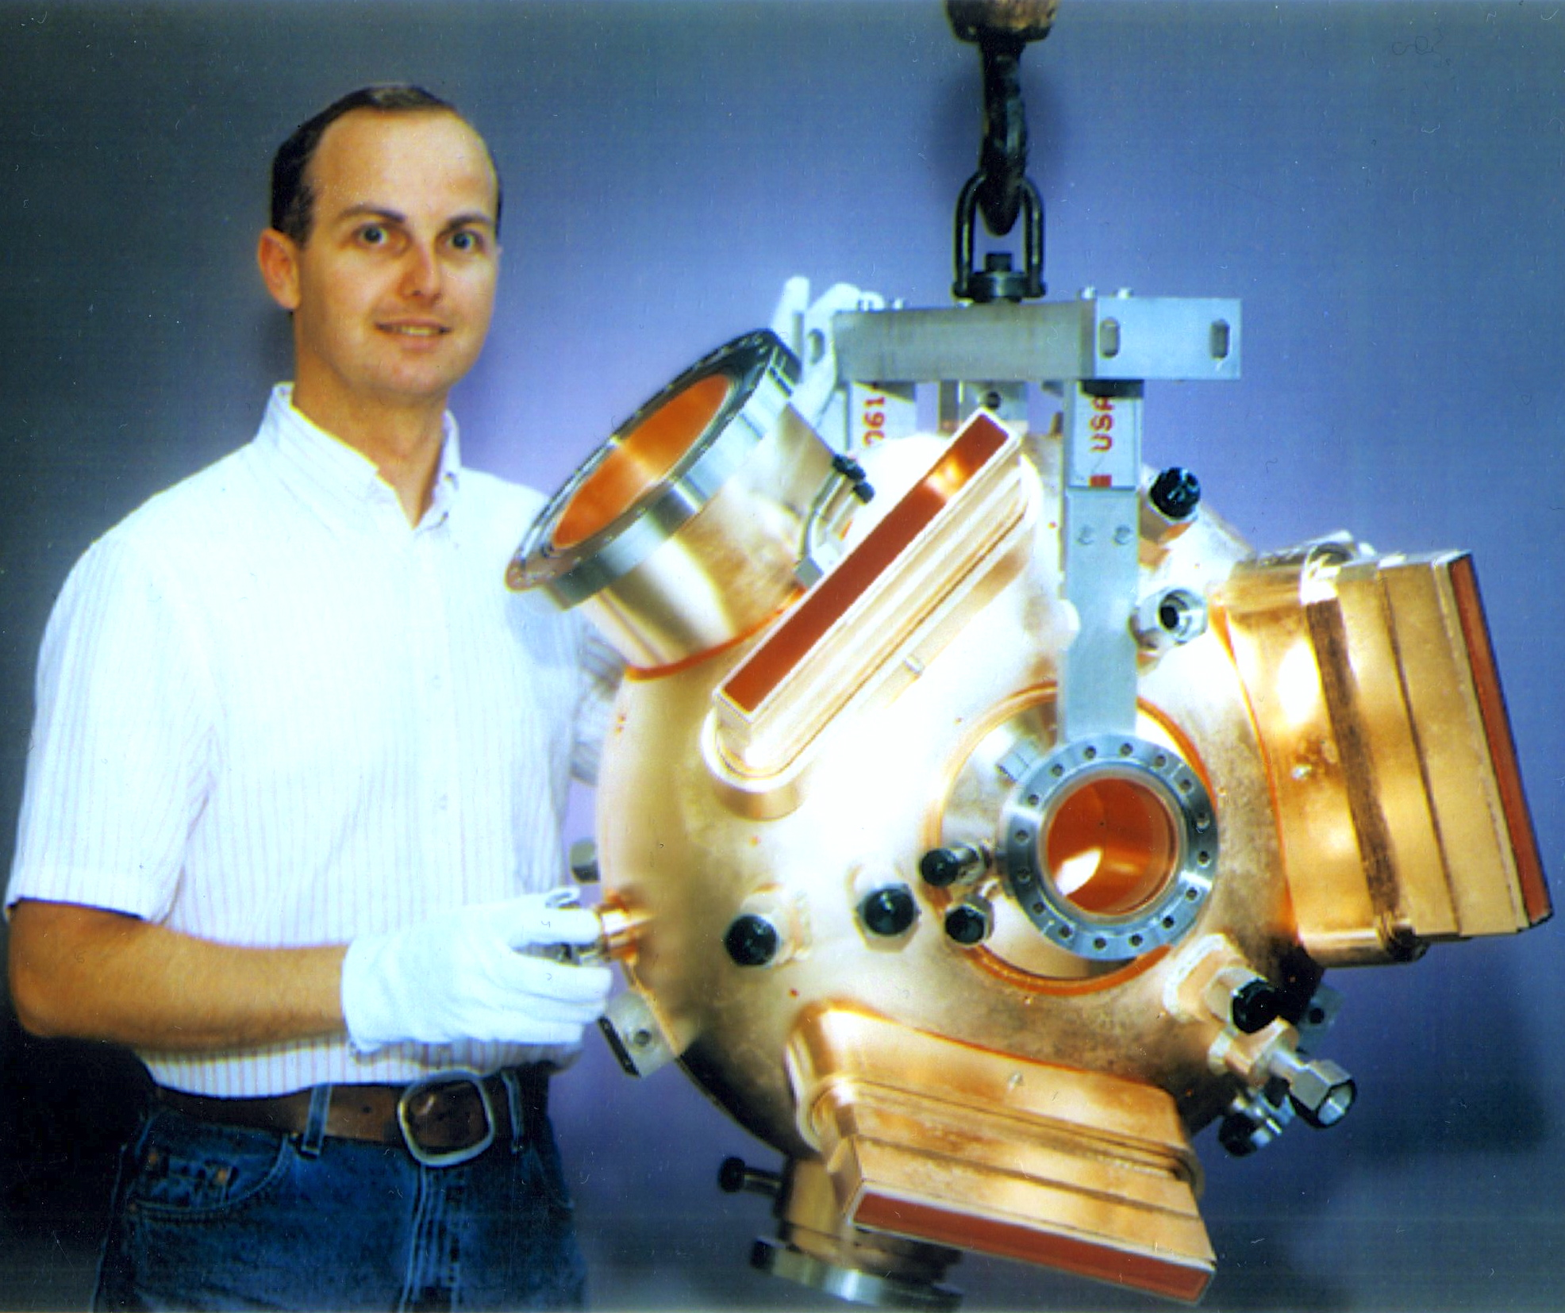
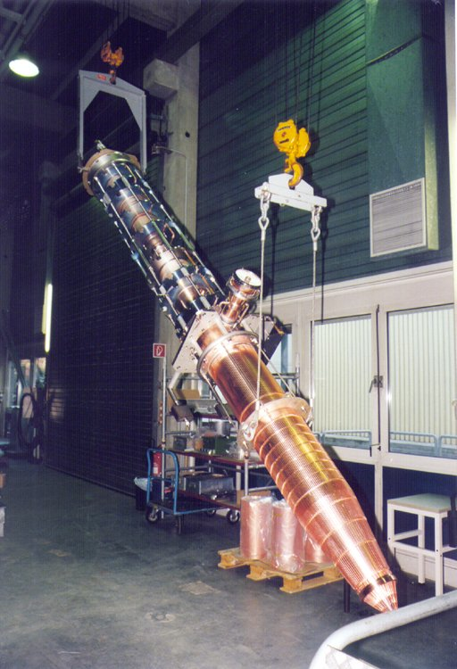




RF Cavities
Electron collider ring --- reuse PEP-II RF stations
  476 MHz HOM damped 1-cell cavities, 34 cavities available
  1.2 MW klystrons including power supplies etc., 13 available
Ion collider ring --- design 952.6 MHz HOM damped 1-cell cavities
  High frequency/high voltage for short bunch (re-bucket at energy)
  Double repetition rate for future luminosity upgrade
New HOM damped cavity concept
952.6 MHz single cell 4-seater CM

Slide 29
Multi-Step Electron Cooling Scheme
Cooling of ion beams in the MEIC is critical in delivering high luminosity over a broad CM energy range
  Help accumulation of positive ions
  Reduce the emittance
  Maintain the emittance
DC cooler
BB cooler
ion sources
Booster
(0.285 to 8 GeV)
collider ring
(8 to 100 GeV)
ion linac
Ring | Cooler | Function | Ion energy (GeV/u) | Electron energy (MeV)
Booster ring | DC | Injection/accumulation of positive ions | 0.11 ~ 0.19 (injection) | 0.062 ~ 0.1
 |  | Emittance reduction | 2 | 1.1
Collider ring | Bunched Beam Cooling (BBC) | Maintain emittance during stacking | 7.9 (injection) | 4.3
 |  | Maintain emittance | Up to 100 | Up to 55

Slide 30
Bunched Beam Electron Cooler
Baseline cooling requirements
  Emittance 0.5 to 1 mm-mrad -> reduce IBS effect
  Magnetized beam, up to 55 MeV energy, 200 mA current
  Linac for acceleration
  Must utilize energy-recovery-linac (beam power is 11 MW)
Solution : cooling by a bunched electron beam
Electron Cooling: MOPMN011, TUPWI037, TUPMA034, TUPMA035, TUPWI038, TUPWI040, WEPMN025
ion bunch
Electron energy | MeV | up to 55
Current and bunch charge | A / nC | 0.2 / 0.42
Bunch repetition | MHz | 476
Cooling section length | m | 60
RMS Bunch length | cm | 3
Electron energy spread | 10⁻⁴ | 3
Cooling section solenoid field | T | 2
Beam radius in solenoid/cathode | mm | ~1 / 3
Solenoid field at cathode | KG | 2
Cooling section solenoid
electron bunch
energy recovery
injector
SRF Linac
dump

Slide 31
e-p Luminosity
10³⁴
10³³
The baseline performance requires a ERL bunched beam cooler but no circulator cooler

Slide 32
Recent and ongoing events
MEIC redesign effort (cost reduction) July – December 2014
- Larger ring (2.1 km)
- PEP-II magnets, RF for e-ring
- Super-ferric magnets
Internal cost review (Dec. 2014)
NSAC Cost Review January 2015
NSAC LRP working group April 2015
Presently:
Design optimization
Pre-project R&D
Preparation for Conceptual Design Report

Slide 33
MEIC Realization Imagined
Activity Name | 2010 | 2011 | 2012 | 2013 | 2014 | 2015 | 2016 | 2017 | 2018 | 2019 | 2020 | 2021 | 2022 | 2023 | 2024 | 2025
12 GeV Upgrade
FRIB
EIC Physics Case
NSAC LRP
EIC CD0
EIC Machine Design/R&D
EIC CD1/Downsel
EIC CD2/CD3
EIC Construction
Start EIC construction after FRIB completion
Can operate 12 GeV CEBAF for physics during construction

Slide 34

eRHIC Realization Imagined

Slide 35
Conclusions
The EIC is well on the way of being identified as the major future project in Nuclear Physics
2 designs exists for the accelerator complex: the MEIC at JLAB, based on a figure-8 collider, and eRHIC at BNL, based on a e- ERL linac colliding with one of the RHIC rings
A process is in place to develop the designs in to CDR’s, select the most appropriate, proceed to construction in the early 2020’s and to operations in the late 2020
Hopefully I succeeded in conveying how challenging and exciting the EIC is, so I hope some of you will join us to make it a reality!

Slide 36
Backup Slides

Slide 37
Electron Ring Optics Parameters
Electron beam momentum | GeV/c | 10
Circumference | m | 2154.28
Arc net bend | deg | 261.7
Straights’ crossing angle | deg | 81.7
Arc/straight length | m | 754.84/322.3
Beta stars at IP β*_{x,y} | cm | 10/2
Detector space | m | -3 / 3.2
Maximum horizontal / vertical β functions β_{x,y} | m | 949/692
Maximum horizontal / vertical dispersion D_{x,y} | m | 1.9 / 0
Horizontal / vertical betatron tunes ν_{x,y} |  | 45.(89) / 43.(61)
Horizontal / vertical chromaticities ξ_{x,y} |  | -149 / -123
Momentum compaction factor α |  | 2.2 ×10⁻³
Transition energy γ_{tr} |  | 21.6
Horizontal / vertical normalized emittance ε_{x,y} | µm rad | 1093 / 378
Maximum horizontal / vertical rms beam size σ_{x,y} | mm | 7.3 / 2.1

Slide 38
Ion Collider Ring Parameters
All design goals achieved
Resulting collider ring parameters
Proton energy range | GeV | 20(8)-100
Polarization | % | > 70
Detector space | m | -4.6 / +7
Luminosity | cm⁻²s⁻¹ | > 10³³
Circumference | m | 2153.89
Straights’ crossing angle | deg | 81.7
Horizontal / vertical beta functions at IP β*_{x,y} | cm | 10 / 2
Maximum horizontal / vertical beta functions β_{x,y} _{max} | m | ~2500
Maximum horizontal dispersion D_{x} | m | 3.28
Horizontal / vertical betatron tunes ν_{x,y} |  | 24(.38) / 24(.28)
Horizontal / vertical natural chromaticities ξ_{x,y} |  | -101 / -112
Momentum compaction factor α |  | 6.45 × 10⁻³
Transition energy γ_{tr} |  | 12.46
Normalized horizontal / vertical emittance ε_{x,y} | µm rad | 0.35 / 0.07
Horizontal / vertical rms beam size at IP σ*_{x,y} | µm | ~20 / ~4
Maximum horizontal / vertical rms beam size σ_{x,y} | mm | 2.8 / 1.3

Slide 39

Ion Polarization in Booster
No special care is needed for ion polarization before the booster
  highly polarized ion source + no polarization loss in the linac
Polarization in Booster stabilized and preserved by a single weak solenoid
  0.7 Tm at 9 GeV/c
  ν_{d} / ν_{p} = 0.003 / 0.01
Longitudinal polarization in the straight with the solenoid
Comparison: Conventional 9 GeV accelerators require B||L of ~30 Tm for protons and ~110 Tm for deuterons
B_{II}L
Booster
beam from Linac
to Collider Ring

Slide 40


Ion Polarization in Collider
“3D spin rotator” rotates the spin about any chosen direction in 3D and sets the stable polarization orientation
Spin-control solenoids
Lattice quadrupoles
Vertical-field dipoles
Radial-field dipoles
x
y
z
z
Placement of 3D spin rotator in the collider ring
Integration of 3D spin rotator into the collider lattice
  seamless integration into virtually any lattice
Another 3D spin rotator suppresses the zero-integer
spin resonance
3D Spin
Rotator
ion
IP
Ion polarization: TUPWI029, TUPWI030

Slide 41
Electron Polarization
Comprehensive electron polarization strategies:
  Vertically-injected polarized electron beam from CEBAF
  Vertical polarization in the arcs (to avoid spin diffusion) and longitudinal at collision points
  Spin rotator for the polarization rotation
  Spin flipping through changing the source polarization
  Polarization configuration with figure-8 geometry removes electron spin tune energy dependence
  Compton polarimeter has been integrated to the interaction region design and is considered to measure the electron polarization
Spin Rotator
Photon
calorimeter
Laser + Fabry Perot cavity
γ_{c}
Low-Q² tagger for
low-energy electrons
Magnetic field
Low-Q² tagger for high-
energy electrons
Polarization
Electron
tracking detector
e⁻ beam
IP
e⁻
IP
Solenoid decoupling
Energy (GeV) | 3 | 5 | 7 | 9 | 10
Estimated Pol. Lifetime (hours) | 66 | 5.2 | 2.2 | 1.3 | 0.8
Half Sol.
Dec. Quad. Insert
Half Sol.

